Slide 1

CLUSTERING
WORKSHOP on
Data Analytics Using Python
Presented by
Kirti Jain

Slide 2
Objectives
Understand the difference between Supervised and Unsupervised Learning.
Learn Clustering and K-means Clustering.
Implement K-means Clustering in Python.

Slide 3
Supervised Learning Unsupervised Learning
Types of Learning

Slide 4
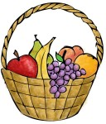
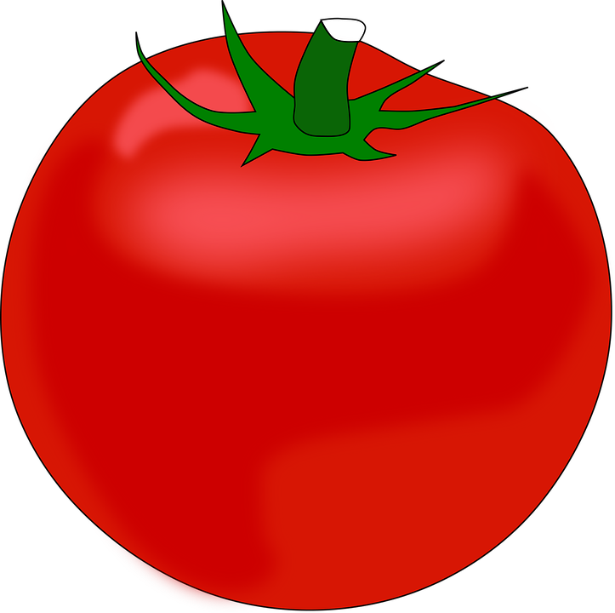


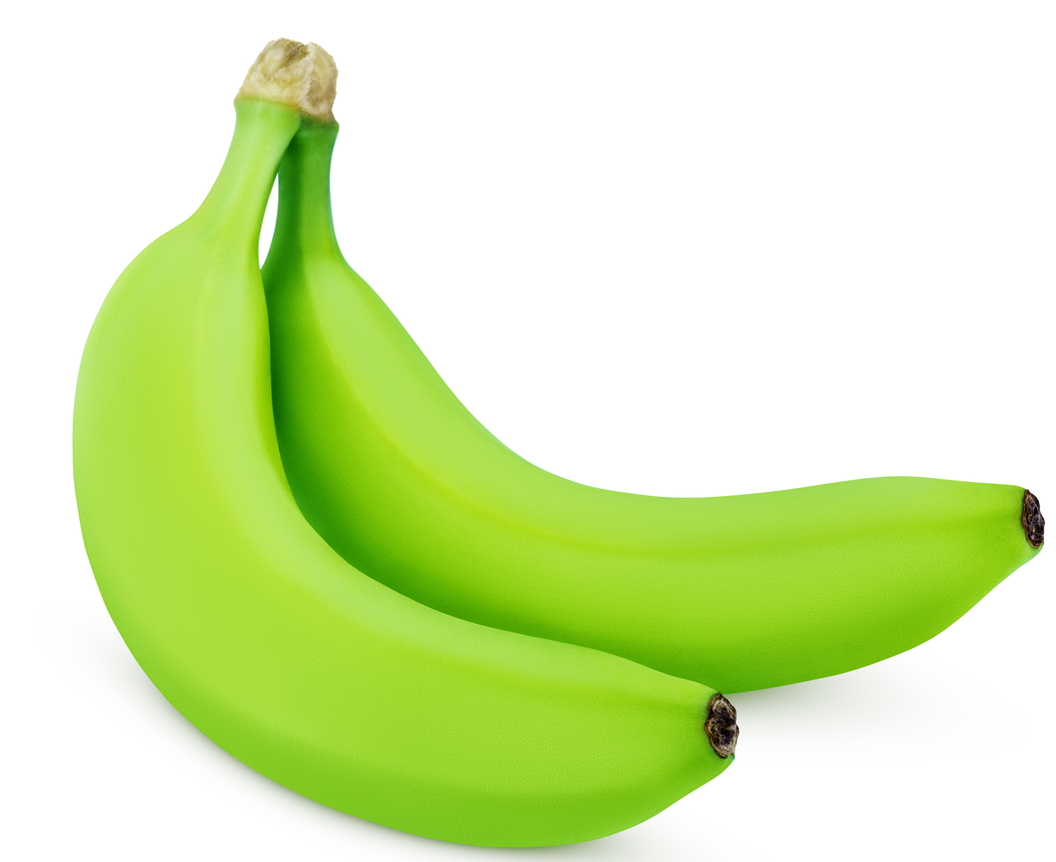

Supervised Learning
Pick a new fruit (test data) from basket.
Color is Red.
Rounded shape with depression at the top.
Size is big.
Learn from training data:
Size | Color | Shape | Fruit name
Big | Red | Rounded shape with depression at the top. | Apple
Small | Red | Heart-shaped to nearly globular. | Cherry
Big | Green | Long curving cylinder. | Banana
Small | Green | Round to oval, bunch shape cylindrical. | Grape
This is an apple.
Put it in Apple group.
Supervised learning: Learning from the known label data to create a model then predicting target class for the given input data.
All classification and regression algorithms come under supervised learning. ( Logistic Regression, Decision Trees, k-Nearest Neighbors, Naïve Bayes…)

Slide 5
Unsupervised Learning
Color
RED color group
GREEN color group
Size
Given data but no labels .
Task is to arrange then as groups !
SMALL size group
BIG size group
Unsupervised learning: Learning from the unlabeled data to differentiating the given input data.
All clustering algorithms come under unsupervised learning algorithms.
K – Means clustering
Hierarchical clustering

Slide 6
What is Clustering ?
Clustering is the classification of objects into different groups, or more precisely, the partitioning of a data set into subsets (clusters), so that the data in each subset (ideally) share some common trait - often according to some defined distance measure.
Unsupervised Learning.
A good clustering method will produce clusters with :
High intra-class similarity
Low inter-class similarity

Slide 7
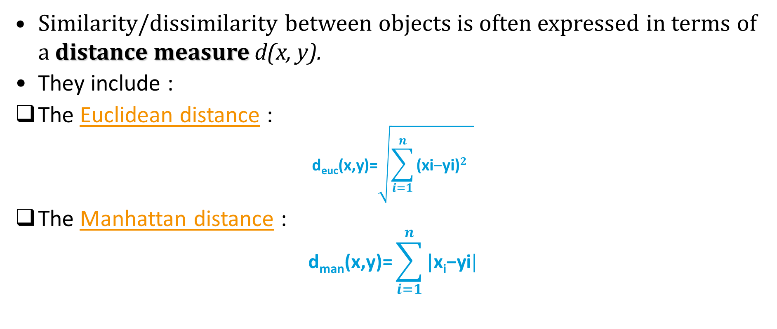
Distance Measures
Similarity/dissimilarity between objects is often expressed in terms of a distance measure d(x, y).
They include :
The Euclidean distance :
$$\text{d}\text{euc}\text{(}\text{x}\text{,}\text{y}\text{)=}\sqrt{\sum_{i=1}^{n}{\text{(}\text{xi}\text{−}\text{yi}\text{)}2} }$$
The Manhattan distance :
$$\text{d}\text{man}\text{(}\text{x}\text{,}\text{y}\text{)=}\sum_{i=1}^{n}{\text{|}\text{x}\text{i}\text{−}\text{yi}|}$$

Slide 8
Distance Measures example
2D example
x₁ = (2,8)
x₂ = (6,3)
Euclidean distance
Manhattan distance
10
X₁ = (2,8)
5
5
$$d\left(x1,x2\right)=\sqrt{{\left|2−6\right|}^{2}+{\left|8−3\right|}^{2}}=\sqrt{41} =6.4$$
X₂ = (6,3)
$$d(x1,x2)=\left|2−6\right|+\left|8−3\right|=9$$
0
5
10
4

Slide 9
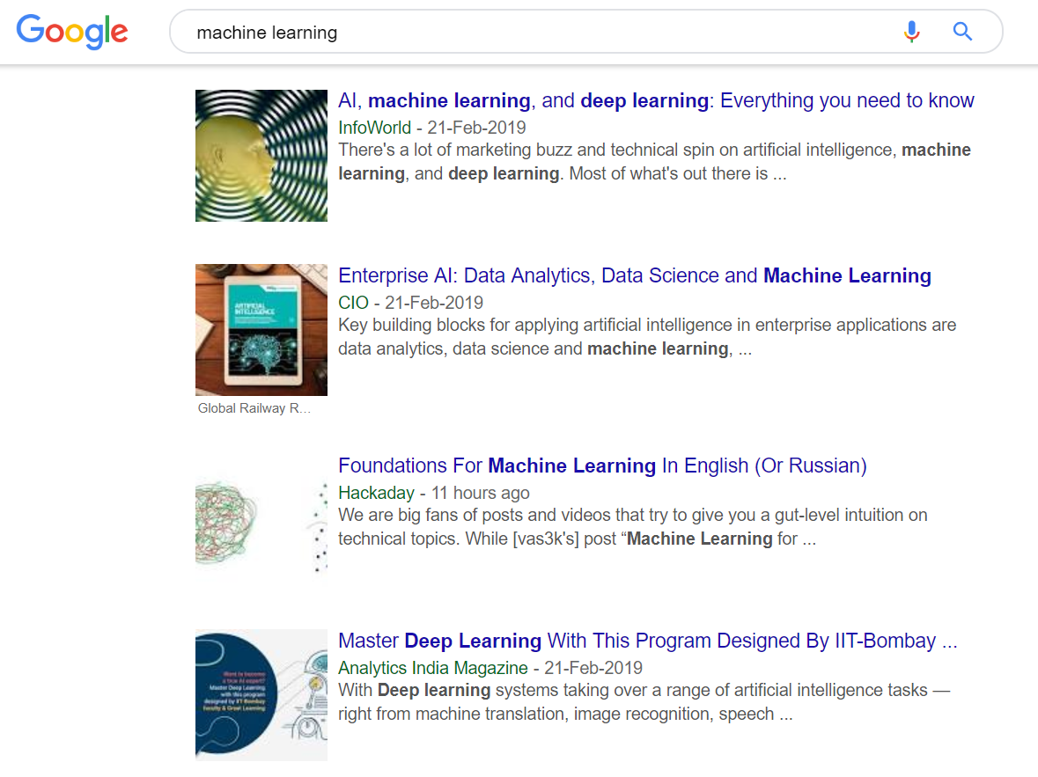
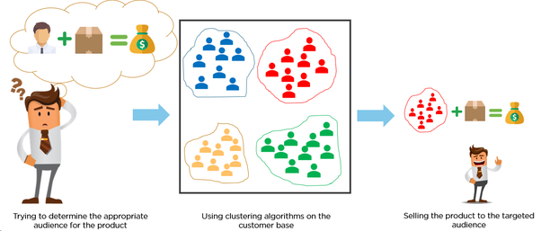
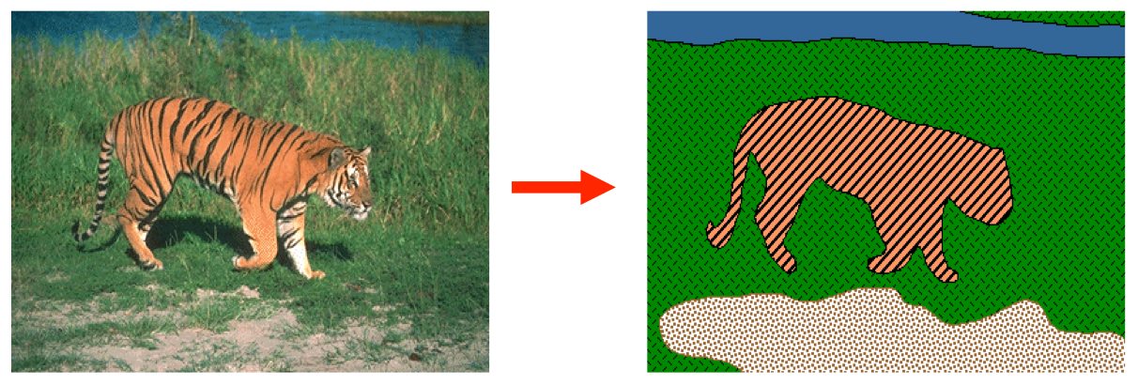
Why Clustering ?
Organizing data into clusters shows internal structure of the data.
Ex. Clustering genes.
Sometimes partitioning is the goal.
Ex. Market segmentation.
Prepare for other AI techniques.
Ex. Summarize news (cluster and then find centroid)
Image Segmentation ( Break up the image into meaningful or perceptually similar regions)

Slide 10
Clustering Algorithms
Partition Algorithms (Flat)
K- means
Hierarchical Algorithms
Agglomerative (bottom-up)
Divisive (top-down)

Slide 11
K – Means Clustering
Partitional Clustering approach.
The k-means algorithm is an algorithm to cluster n objects based on attributes into k partitions, where k < n.

Slide 12
Imagine you have some data that you can plot on a line.
In this case, the data make three, relatively obvious clusters.
We’ll use K-means clustering !!

Slide 13
Step 1: Select the number of clusters you want to identify in your data. This is the “K” in K-means Clustering.
Select K = 3 i.e., we want to identify 3 clusters.

Slide 14
Step 2: Randomly select 3 distinct data points.
These are the initial clusters.

Slide 15
Distance from 1st point to the orange cluster.
Distance from 1st point to the green cluster.
Distance from 1st point to the blue cluster.
Step 3: Measure the distance between the 1st point and the three initial clusters.

Slide 16
Now do the same thing for the next points.
Measure the distances…
Assign the point to the nearest cluster.
Step 4: Assign the 1st point to the nearest cluster. In this case, the nearest cluster is the blue cluster.

Slide 17
Measure the distance…
Assign the point to the nearest cluster.
Now figure out which cluster the 3rd point belongs to.

Slide 18
Rest of the points are closest to the orange cluster , so they’ll go in that one, too.

Slide 19
Now that all the points are in clusters, we will go on to…
Step 5 : Calculate mean of each cluster.

Slide 20
Then we repeat what we just did (measure and cluster) using the mean values.

Slide 21
Then we repeat what we just did (measure and cluster) using the mean values.

Slide 22
Then we repeat what we just did (measure and cluster) using the mean values.

Slide 23
Then we repeat what we just did (measure and cluster) using the mean values.

Slide 24
Then we repeat what we just did (measure and cluster) using the mean values.

Slide 25
Then we repeat what we just did (measure and cluster) using the mean values.
Since the clustering did not change at all during the last iteration, we’re done.

Slide 26
K-means clustering is pretty terrible compared to what we did by eye.

Slide 27
We can assess the quality of the clustering by adding up the variation within each cluster.
Total variation within the cluster
Since, K-means clustering can’t see the best clustering, do the whole thing over again with different starting points.

Slide 28




K-means : Pizza Hut Clustering Example.
Let us suppose the following points are the delivery locations for Pizza.
Assign the points to the nearest cluster center based on the distance between each center and the points.
Find the distances of each point as shown.
Lets locate three cluster centers randomly.
Re-assign the cluster centers and locate nearest points, and calculate the distance.
Re-assign the cluster centers and locate nearest points.
C2
C2
C1
C1
C3
C3
Form three clusters.

Slide 29
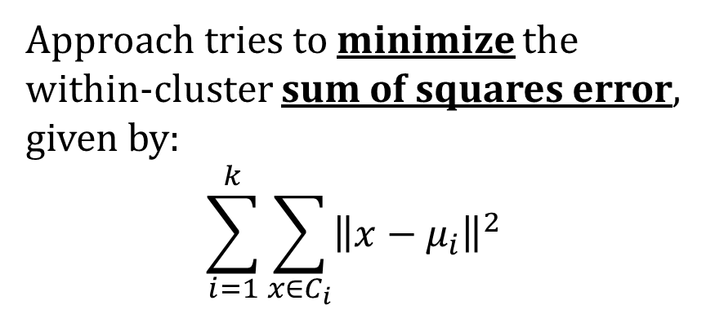
How the K-Mean Clustering algorithm works?
Approach tries to minimize the within-cluster sum of squares error, given by:
$$\sum_{i=1}^{k}{\sum_{x∈C_{i}}{{\left\|x−μ_{i}\right\|}^{2}}}$$
START
Number of Clusters, K
Re-calculate new centroids.
Centroid
if change in Clusters
END
Calculate distance from each object to each centroid.
Clusters are stable.
Assign each object to closest centroid based on minimum distance.

Slide 30
Implementation of K-Means algorithm in Python on Google Collab.

Slide 31
Thank you !

